Slide 1
Agenda
Review
Multi Row Functions
aggregating data using group functions
Leveraging the GROUP BY ….. HAVING clauses to create and filter groups
obtaining summary information (such as averages) for groups of rows.
how to group rows in a table into smaller sets and - how to specify search criteria for groups of rows.
Group Functions and Grouping Rows
Nesting Group Functions

Slide 2
Referential Integrity
SEASONS
COACH
Assuming no key fields, can you enforce referential integrity with tables as is?
What are the steps to do this?

Slide 3
SQL Functions
What is another name for Single-row functions?
Scaler functions
What is another name for Multiple-row functions?
Aggregate functions
What is the difference between the two?
A single-row function returns one result for each row. These functions operate on single rows only and return one result for every row acted on.
A multiple-row function returns one result per set of rows. Functions can manipulate groups of rows to give one result per group of rows. These functions are also called group functions.

Slide 4
Single Row Functions Categories
Character Functions
Numeric Functions
Datetime Functions
Conversion Functions

Slide 5
Group Functions
Group functions (multi-row functions)
Operate on sets of rows to give one result per group.
These sets may comprise the entire table or the table split into groups
SELECT AVG(SALARY) FROM STAFF …..
Every row with SALARY value is summed up and then total divided by number of rows, producing a SINGLE result

Slide 6
Group Functions Examples
AVG
COUNT
MAX
MIN
SUM
STDDEV
VARIANCE

Slide 7
Group Functions Examples
AVG ( [distinct | ALL] EXPRE}) n )
Average value of n, ignoring null values
COUNT ( { * [distinct | ALL] })
Number of rows where expr evaluates to something other than null - count all selected rows using * including duplicates and nulls unless you use distinct
MAX([DISTINCT|ALL]expr)
Maximum value of expr, ignoring null values
MIN([DISTINCT|ALL]expr)
Minimum value of expr, ignoring null values
SUM([DISTINCT|ALL]n)
Sum values of n, ignoring null values

Slide 8


Group Functions Examples
STDDEV([DISTINCT|ALL]n)
Standard deviation of n, ignoring null values
VARIANCE ([DISTINCT|ALL]n)
Variance of n, ignoring null values
You can have distinct or all

Slide 9
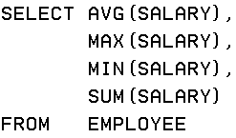
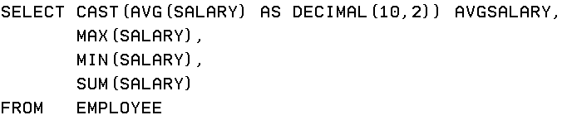
Group Functions Examples
PROBLEM: President wants to know data about salaries, such as the average salary, what the highest and lowest paid person's salary is and the company's total salary payout.

Slide 10

Group Functions – Groups of Data
All group functions have treated the table so far as one large group
Sometimes the information needs to be divided into smaller groups
Example: Average by department
This will FAIL !!

Slide 11
Group Functions – Groups of Data
The use of the department id results in a row of output for each row in the employee table
The AVG(SALARY) wants a single result for the entire table.
There is no sensible way to display that.

Slide 12
Group Functions – Groups of Data
Introduce the GROUP BY clause to resolve

Slide 13
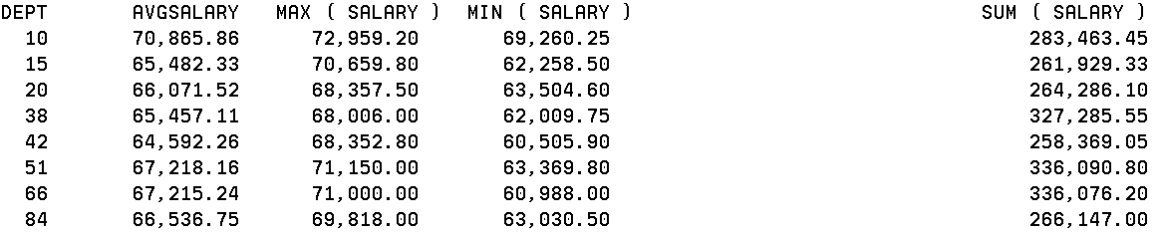
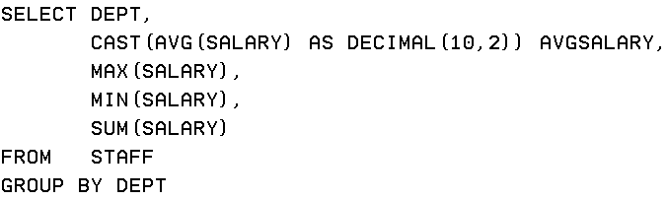
Group Functions Examples
For STAFF, how do you get this result:

Slide 14
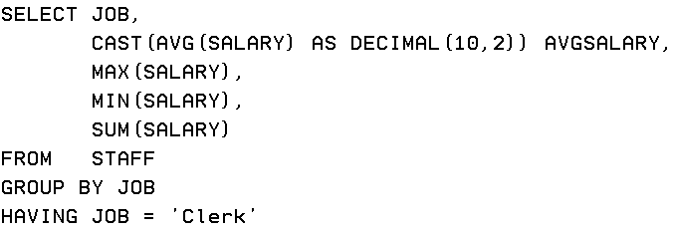
Group Functions Examples
Fof STAFF, how do you get this result:
How do you just report on Clerks?

Slide 15
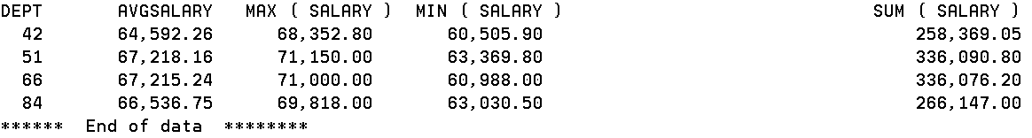
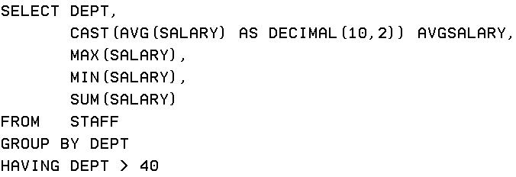
Group Functions Examples
Fof STAFF you are only interested in some of the departments

Slide 16
The Where clause filters out rows that don’t meet a search condition
The Having clause filters out entire groups that don’t meet a search condition

Slide 17
Group Functions Guidelines
DISTINCT - Makes the function consider only non-duplicate values
ALL - Makes function consider every value
DEFAULT value is ALL and does not need to be specified
The DATA TYPES with the syntax expr argument may be CHAR, VARCHAR2, NUMBER, DATE
All group functions ignore null values.

Slide 18

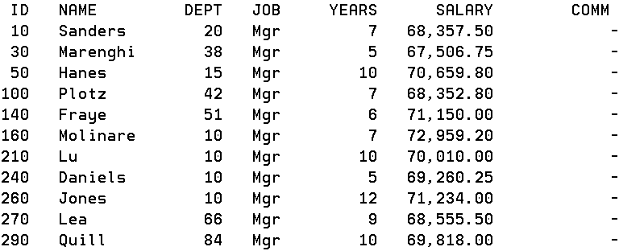

Functions ignore null values
.

Slide 19


Group Functions – MIN / MAX
You can use MIN and MAX for the following
Numeric
Character
Date
PROBLEM: Find the most junior (newest) and most senior (longest employed) employee.
Is MIN the most years or the least years with the company ?

Slide 20


Group Functions – MIN / MAX
PROBLEM: Find the first person alphabetically by last name and find the last employee by last name
Applied to character columns
Note: You may want to use UPPER or LOWER if you are unsure about the case consistency of the data in the table. You can still use INITCAP to format your result set.

Slide 21

Group Functions – COUNT
COUNT (*) – returns the number of rows in a table
SELECT COUNT (*) FROM EMPLOYEES
Count supplies the number of rows that satisfies the SELECT statement in a table
PROBLEM: Find the percentage of employees that receive a commission

Slide 22
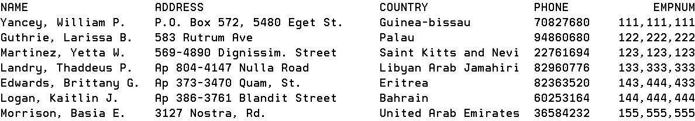
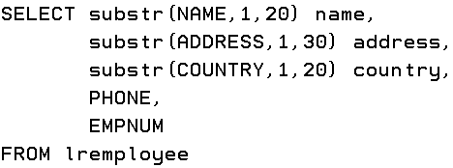
Group Functions – COUNT
PROBLEM: How many countries are there in the LREmployee table ?

Slide 23




Group Functions – COUNT
Are there 100 countries in the LREmployee table ?
It actually was less than 100

Slide 24
Group Functions – NULLS
PROBLEM: What is the average commission paid out to employees ?
Two interpretations:
Average commission payment for those employees who receive commission
Average commission payment for all employees, including those who receive no commission.
Two situations:
Is the lack of commission represented as 0 in our table ?
Is the lack of commission represented as NULL in our table ?

Slide 25






AVG with NULL values
SELECT SUM(COMM) FROM STAFF returns 12319.45
12319.45/35 = 351.98
12319.45/24 = 513.31

Slide 26
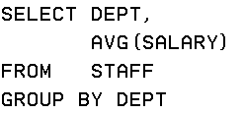
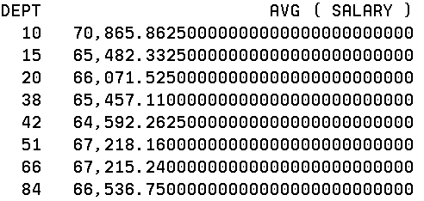
AVG with Group By
To clean up the output, there are a few options including ROUND

Slide 27
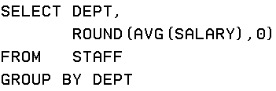
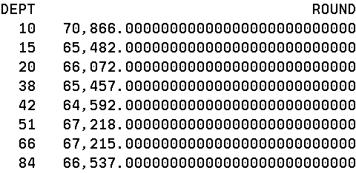
AVG with ROUND
To clean up the output, there are a few options including CAST

Slide 28
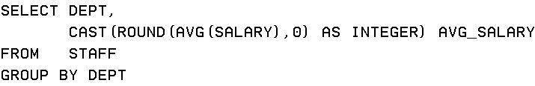
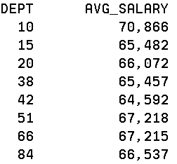
AVG
We included the group by column in the result set, usually a good idea but not always necessary

Slide 29
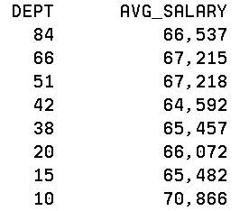
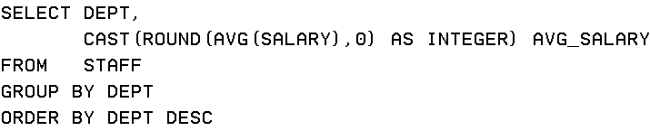
AVG with sorting
How do you get this result?

Slide 30
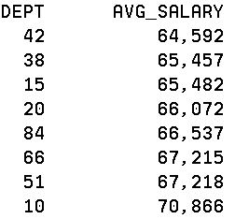
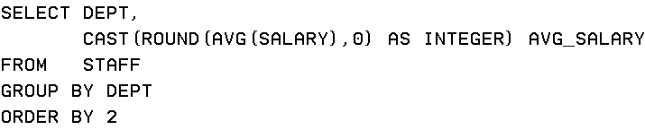
AVG – order by average salary
How do you get this result?

Slide 31
Group Functions – Groups of Data
Grouping by more than 1 column
Leverage groups within groups
PROBLEM: Display the total salary paid to each job title within each department

Slide 32
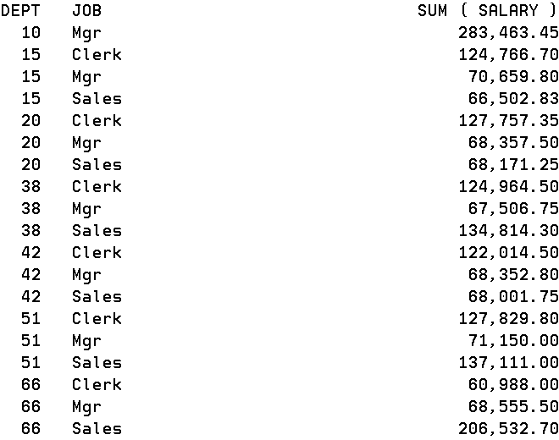
Group Functions – Groups of Data

Slide 33
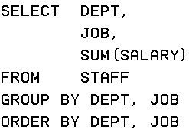
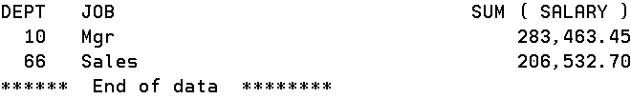
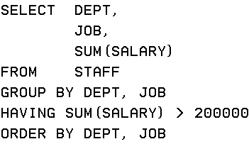
Group Functions – Groups of Data
Limit this to where salaries are greater than 200000

Slide 34
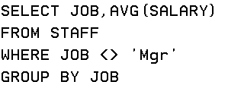

Group Functions – Groups of Data
Can you use a Where and a Group By in the same statement?
What is the average salary for all job types excluding manager?

Slide 35
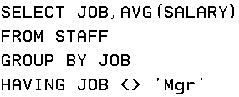
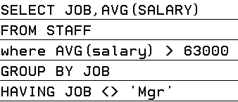
Group Functions – Groups of Data

Slide 36
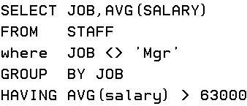

Group Functions – Groups of Data

Slide 37
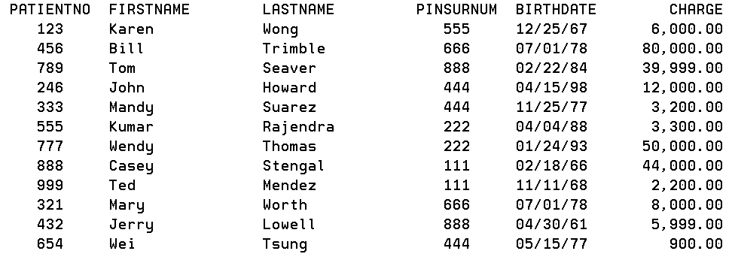
PATIENT3

Slide 38
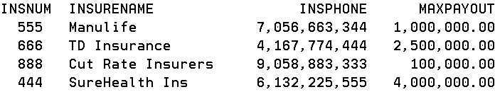
INSURANCE3

Slide 39
Problem
Show each insurance company in insurance number order, how many patients have insurance with that company, what is the highest and lowest patient charges the companies covered and what would be the maximum amount they would ever pay out.

Slide 40
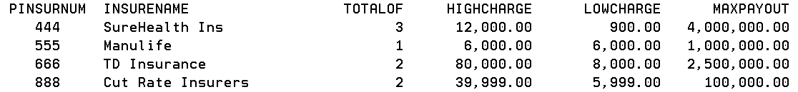
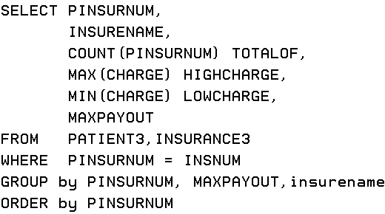
Produce this output

Slide 41
Problem
Show each insurance company, how many patients have insurance with that company what is the highest and lowest patient charges the companies covered and what would be the maximum amount they would ever pay out.
Remove the maximum payout any company can make and add the average payout they made

Slide 42
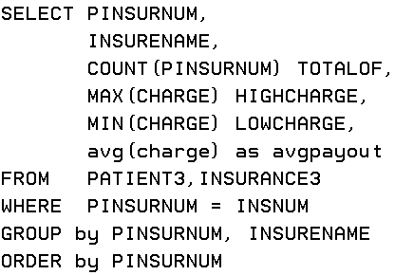
Produce this output

Slide 43
Don’t include any company that has the same amounts for high charge and low charge
Clean it up so 5,366.66666666… shows as 5367

Slide 44
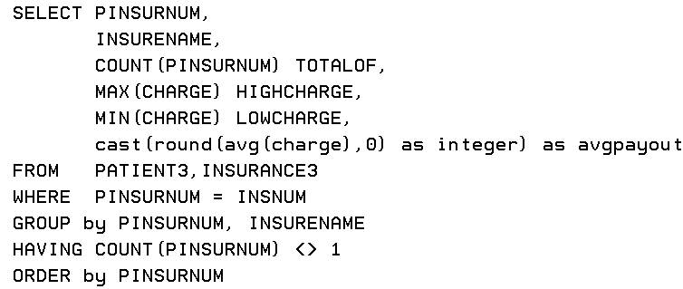
Exclude where the totalof = 1

Slide 45
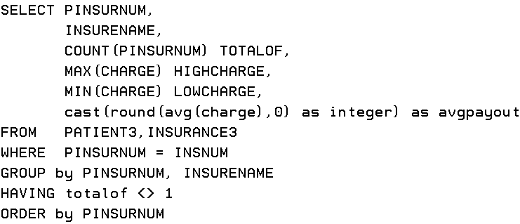
Does this work?
Can you use totalof in having clause?

Slide 46
Lab 2
Lab 2 for Wednesday already available and Lecture 3 Powerpoint will be uploaded sometime tonight.

